Slide 1
Warm-Up 23OCT18
Why were slaves in the northern colonies less likely to retain their African heritage and culture compared to slaves in the south?

Slide 2
Warm-Up 23OCT18
Why were slaves in the northern colonies less likely to retain their African heritage and culture compared to slaves in the south?
Isolation – Far fewer slaves in the north, less opportunity to share and pass down heritage and culture
In the south, particularly in areas where malaria was prevalent, many slaves worked without much supervision and were able to share and retain parts of their culture
Google Classroom – jhm11dr

Slide 3
Plantation Slavery/Culture
Increase in slave population:
Importation of slaves increased dramatically
Slave population by birth grew
Slave population in VA and MD accounted for 61% of all slaves @ 1750
Slave population in SC and GA accounted for 17% of all slaves @ 1750

Slide 4
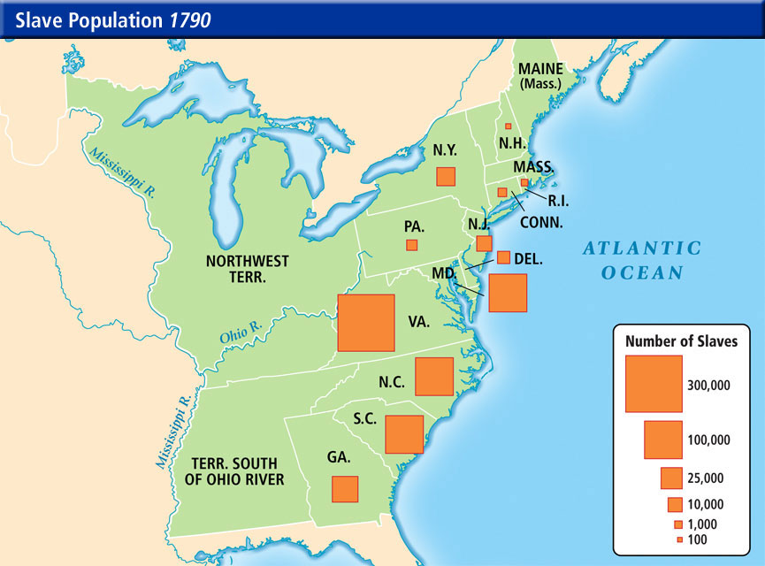
Plantation Slavery/Culture

Slide 5
Plantation Slavery/Culture
Drop in slave importation between 1750-1760 was due in large part to the French-Indian War
Drop in slave importation between 1770-1775 can be attributed to the growing conflict b/w the colonies and Great Britain

Slide 6
Plantation Slavery/Culture
Large landowning slave holders rarely interacted or saw their slaves
Spent time in cities away from their plantations
Divided slaves into smaller groups to avoid rebellions
Small landowners often owned five slaves or less
Worked together and often formed personal bonds

Slide 7
Plantation Slavery/Culture
Trade occupations that Black men took on by the mid-18th Century:
Carpenter
Blacksmith
Carter - Carries or conveys goods in a cart
Cooper - Maker of wooden barrels
Miller – Grinds grains/makes flour
Sawyer - A person who saws timber
Tanner - A person who tans hides for leather
Shoemaker
Black women were resigned to field work and domestic work

Slide 8
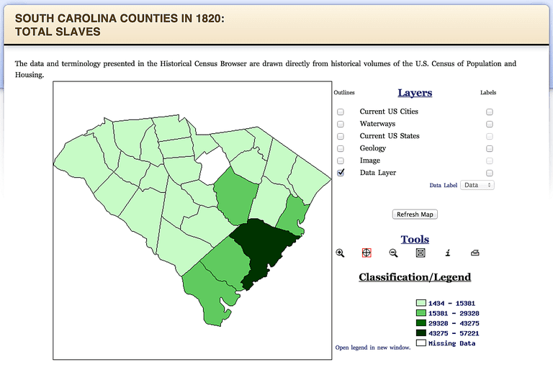
Plantation Slavery/Culture
South Carolina was perhaps the only colony where slaves outnumbered Whites
South Carolina was settled by planters who immigrated from Barbados
Chattel slavery was practiced from the beginning
Heavy dependence on slave labor
Largest export crop was rice

Slide 9
Plantation Slavery/Culture
Rice plantations and Sugar plantations had this in common:
Whites were in the minority of the population
Slaves worked largely independently and segregated from the White population
Slave population did not grow through reproduction, but by importation

Slide 10
Plantation Slavery/Culture
South Carolina had established the strictest slave codes in North America in the fear of slave revolts
Curfews allowed African Americans to be captured on sight
Ironically, SC armed African Americans to fight against Spanish and Indian raids

Slide 11
Plantation Slavery/Culture
Slave populations in South Carolina:
Creoles (slaves born in America) lived closely to Whites
Creoles were often Mulattos were allowed to move about Charlestown and Savannah under supervision
On the plantations, slaves had greater autonomy and more of their native culture
Slaves on rice plantations had “daily tasks”, versus working in gangs
After the tasks were completed, slaves could work for themselves

Slide 12
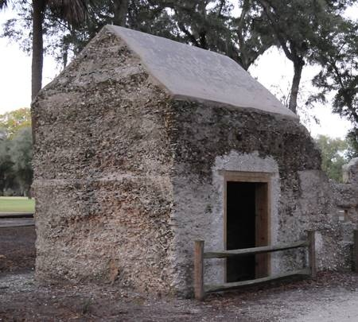
Plantation Slavery/Culture
Housing (Chesapeake v. SC-GA)
In Virginia, slaves lived in log cabins with dirt floors and a fireplace with chimney
In SC-GA, houses were built with tabby (combo of lime, oyster shells, sand and mud
Both types of houses had thatched roofs

Slide 13
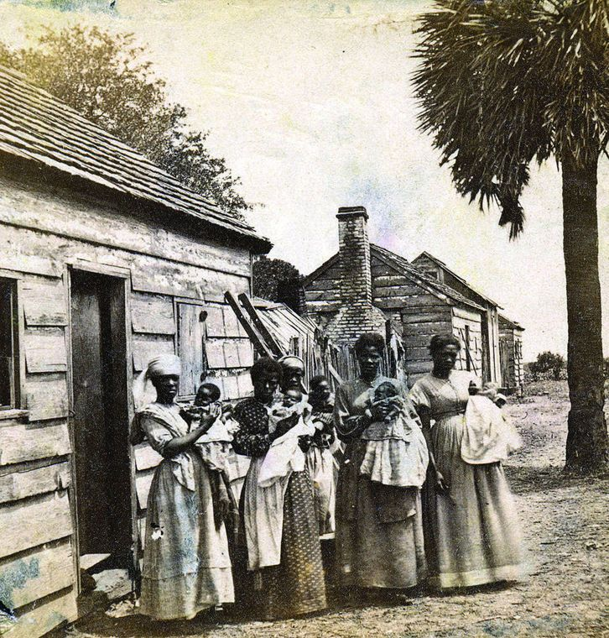
Plantation Slavery/Culture
Clothing:
As homespun cloth replaced cloth from England, African American women dyed the cloth, decorated clothing with ornaments and created African-style headwraps, hats and hairstyles

Slide 14
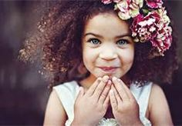
Plantation Slavery/Culture
Miscegenation – children who are of mixed races
Creolization – African parents that produced African American children
Mulattoes – Those of mixed African and European Ancestry

Slide 15
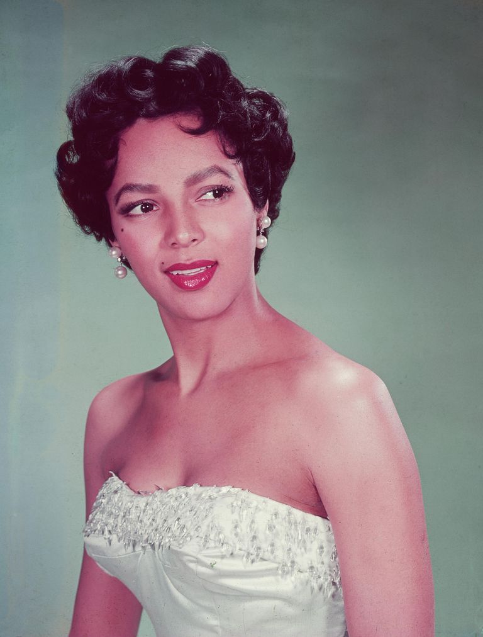
Famous Biracial Americans
FOLLOW ACTIVITY DIRECTIONS AT THE END OF YOUR GUIDED NOTES

Slide 16
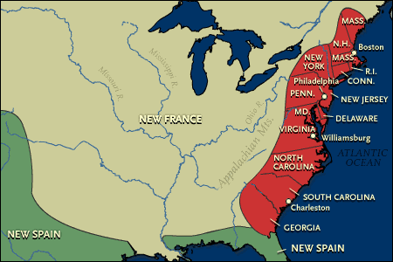
Warm-Up 25OCT18
Which colony had the strictest slave codes?

Slide 17
Warm-Up 25OCT18
Which colony had the strictest slave codes?
South Carolina
Slaves were forbidden to leave the owner's property unless they were accompanied by a white person or had permission. If a slave leaves the owner's property without permission, "every white person" is required to chastise such slaves.
Any slave attempting to run away and leave the colony (later the state) receives the death penalty.
Any slave who evades capture for 20 days or more is to be publicly whipped for the first offense, branded with the letter R on the right cheek for the second offense, and lose one ear if absent for 30 days for the third offense, and castrated for the fourth offense.
Owners refusing to abide by the slave code are fined and forfeit ownership of their slaves.

Slide 18
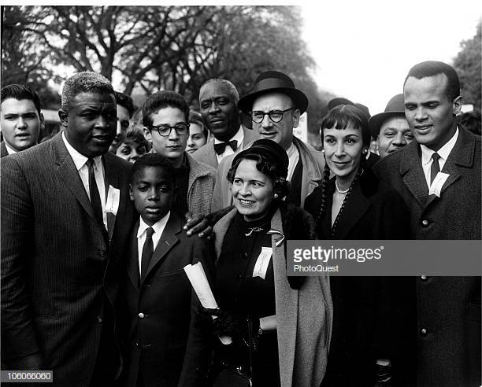
This Date in History
1958: Ten thousand students, led by Jackie Robinson, Harry Belafonte and A. Phillip Randolph, participated in the Youth March for Integrated Schools in Washington

Slide 19
4OCT18 - AGENDA
ACTIVITY – Famous Bi-Racial Americans is due NLT 10:00
TURN IN – Google Docs or Hard Copy
Guided Notes (UNIT 2/PART 3)
Interracial Marriages in the colonial period
African culture (Retained/Lost)
Great Awakening
Gullah/Geechee
Comparing slavery in the different colonial regions

Slide 20
Plantation Slavery/Culture
African Culture Retained:
Memory of West African heritage
Family structure and value of kin
Words, intonation, music, cooking, literature and folk arts
Circle dances and funeral practices
African Culture Lost:
Animist religious practices
Nature languages
Ethnic identities – Ref. “Roots” and Kunta Kinta’s insistence on remaining Mandinka

Slide 21
Plantation Slavery/Culture
Extended Families:
Means to show the importance of family
Methods of passing to the next generation the origins and heritage of their forefathers
Naming customs – After the father or close relative to maintain heritage
Surnames were adopted from the slave-owners

Slide 22
Plantation Slavery/Culture
The Great Awakening:
George Whitefield preached salvation to all – White and Black
This went against the mindset of slave-owners who feared that spiritual equality would be interpreted as earthly equality
Many African Americans eschewed Christianity for their original faiths
The emotional spirituality of the Great Awakening was captured in revivals and led to a greater acculturation of Blacks and Whites and helped create interracial churches
Helped create distinctly Black churches that blended European and African elements

Slide 23
Plantation Slavery/Culture
Gullah and Geechee/Music:
Many traditions of the Gullah and Geechee culture were passed from one generation to the next through language, agriculture, and spirituality.
Ancient African cultures encompassed music into their everyday lives. Dance, story-telling and religious practices are all grounded on the music of the culture.

Slide 24
Plantation Slavery/Culture
Folk literature:
Africans used tales of how weak animals like rabbits outsmarted stronger animals like hyenas and lions to symbolize the power of the common people over unjust rulers.
Africans used similar tales to portray the ability of slaves to outsmart and ridicule their masters.

Slide 25
Plantation Slavery/Culture
African American contributions to colonial culture:
Rice, gumbo, how to cultivate certain crops
Music, introduction of words added to the English language, folk medicine…

Slide 26
Plantation Slavery/Culture
Comparing slavery in the upper Middle and New England colonies:
Emphasis on manufacturing, subsistence farming and growing population, the economy was not suited for slave labor.

Slide 27
Warm-Up 5OCT18
What changes happened in the Free and Slave populations as a result of the Great Awakening?
What were common methods of passive resistance practiced by slaves?

Slide 28
Warm-Up 5OCT18
What changes happened in the Free and Slave populations as a result of the Great Awakening?
George Whitefield preached salvation to all – White and Black
This went against the mindset of slave-owners who feared that spiritual equality would be interpreted as earthly equality
Many African Americans eschewed Christianity for their original faiths
The emotional spirituality of the Great Awakening was captured in revivals and led to a greater acculturation of Blacks and Whites and helped create interracial churches
Helped create distinctly Black churches that blended European and African elements

Slide 29
Warm-Up 5OCT18
What were common methods of passive resistance practiced by slaves?
Break tools
Set fires
Leave draft animals unattended
Work slower
Sometimes house slaves would poison their owners in retaliation to harsh treatment

Slide 30
Plantation Slavery/Culture
Slave life in the North:
Small percentage of the population
Lived in the Master’s House
Worked along side the master and one or two other slaves as an agricultural laborer
In northern cities, slaves were artisans, shopkeepers, messengers, domestic servants and general laborers
New England – least restrictive slave codes
Middle Colonies – Slave codes were stricter, but not as harsh as in the south

Slide 31
Plantation Slavery/Culture
Assimilation of blacks into the larger northern population:
The slaves in the north had almost no contact with traditional African culture
Because of this, they had a hard time retaining their African culture and traditions
Since they lived in such close proximity to their masters, they started to assimilate to the white culture

Slide 32
Warm-Up 22FEB18
I NEED THREE VOLUNTEERS

Slide 33
Warm-Up 22FEB18
THE TOPIC IS INTERRACIAL MARRIAGES
Grab a Chromebook and look up
Loving v. Virginia a write a one paragraph summary of the case before discussion begins

Slide 34
Plantation Slavery/Culture
Comparing slavery in British North America to that of Spanish Florida and French Louisiana:
British start with indentured servitude and moved to chattel slavery
French: Slaves from Senegambia would grow in numbers and reside close to New Orleans
Converted to Roman Catholicism and gained their freedom
Large number of miscegenated children from white men and exploited black women
Hierarchy created on the lightness of skin tone

Slide 35
Plantation Slavery/Culture
Comparing slavery in British North America to that of Spanish Florida and French Louisiana: (Continued)
The number of African slaves in Spanish Florida was small and most were used as soldiers
Many gained status after converting to Catholicism
When the British gained control of Florida in 1763, Black and White inhabitants of St. Augustine fled to Cuba
Plantation system began to grow in Florida under British rule

Slide 36
Plantation Slavery/Culture
African and Native American descent gain status in the Spanish colonies vice British colonies:
The British colonies insisted on strict adherence to segregation to maintain White supremacy.
The borderlands of Spain (Outside of modern day Mexico) had a great number of mixed race Spaniards, who were more accepting of Blacks and Native Americans.
Spain’s royal government started allowing Blacks and Native Americans to pay a fee obtain hereditary rank and move up the social ladder.

Slide 37
Plantation Slavery/Culture
Roles did Black women in Southern slave culture:
The roles/responsibilities of black women were often sexual duties and childbearing
Field work and domestic work (cooking, cleaning, rearing children/nanny)

Slide 38
Warm-Up 8OCT18
How did the “Natural Laws” of John Locke run contrary to the practice of slavery?

Slide 39
Warm-Up 8OCT18
How did the “Natural Laws” of John Locke run contrary to the practice of slavery?
Life, Liberty and Property. In the scope of slavery in the British colonies and later the U.S., these tenets of natural rights were violated.
Slaves did begin to petition for gradual emancipation in Massachusetts, New Hampshire and Connecticut

Slide 40
Plantation Slavery/Culture
Opportunities for Black women in the northern colonies that did not exist in the South:
In the North, Black women succeeded as bakers and weavers.
But in the South, they had few opportunities for work beyond the tobacco and rice fields and domestic labor in the homes of their masters.

Slide 41
Plantation Slavery/Culture
How blacks resist slavery / Goal of resistance:
Enslaved Africans resisted, or rebelled, against their position as slaves in many different ways.
Each expression of resistance by enslaved individuals or groups counted as acts of rebellion against the system of slavery.
The many instances of resistance show that slaves were not victims of slavery who accepted their situation.
Instead they proved their strength and determination in fighting for their freedom.

Slide 42
Plantation Slavery/Culture
“Outliers” and “Maroons”:
Outliers were escaped slaves who shared a common language/homeland and survived by stealing from their master’s estate
Maroon Societies were communities formed by escaped slaves in the Caribbean, Latin America, and the United States
Maroons in Florida joined the Seminole Indian Tribes for protection

Slide 43
Plantation Slavery/Culture
How resistance to slavery evolved as the slave population acculturated:
Abolitionist groups were formed, and slaves could either start rebellions against the slave owners
They could run away or perform small daily acts of resistance such as slowing work down.

Slide 44
Plantation Slavery/Culture
Two major slave rebellions/18th century in colonial America:
In 1712, some twenty-five slaves armed themselves with guns and clubs and set fire to houses on the northern edge of New York City.
They killed the first nine whites who arrived on the scene and then were killed or captured by soldiers.

Slide 45
Plantation Slavery/Culture
Two major slave rebellions/18th century in colonial America:
A second uprising, Cato’s Conspiracy, originated in Stono, South Carolina, in 1739.
England at this time was at war with Spain, and a group of about eighty slaves took up arms and attempted to march to Spanish Florida, where they expected to find refuge.
A battle ensued when the slaves were overtaken by armed whites. Some 44 blacks and 21 whites were killed.

Slide 46
Plantation Slavery/Culture
Summary of the Stono Rebellion: White’s reaction?
20 slaves under Jemmy raided weapons depot and killed everyone inside
More slaves joined as they marched towards Florida
Approximately 30 more whites were killed on the way
Rebellion ended when planters and Native Americans on horseback caught the slaves celebrating
Even though the rebellion ended, the rebellious spirit lived on
1740 – Charleston, SC: Arrested 130 slaves and hanged 10/day
Whites never lost their fear of slave rebellions after the Stono Rebellion

Slide 47
ACTIVITY 8OCT18
Grab a Chromebook and go to
http://americansperspective.com/the-10-most-pressing-issues-facing-21st-century-african-americans/
READ THE ARTICLE, LIST THE TOP 10 AND THEN CHOOSE ONE TOPIC
WRITE YOUR RESPONSE AND THREE WAYS THAT THIS PROBLEM COULD BE ADDRESSED

Slide 48
Warm-Up 23OCT17
In your opinion, what was the most harmful legislative action against Blacks in the United States during the period 1788-1820?

Slide 49
Warm-Up 24OCT17
In the draft of which document was the phrase “cruel war against human nature itself, violating the most sacred rights of life and liberty in the person of a distant [African] people”?

Slide 50
Warm-Up 24OCT17
In the draft of which document was the phrase “cruel war against human nature itself, violating the most sacred rights of life and liberty in the person of a distant [African] people”?
The Declaration of Independence which was drafted by Thomas Jefferson, John Adams and Benjamin Franklin
Deleted by the 2nd Continental Congress after Southern states objected
Only reference to slavery in the Declaration of Independence was to accuse the British of arousing African Americans to revolt against their masters

Slide 51
Warm-Up 26OCT17
How did slavery differ in the New England colonies compared to the Chesapeake region and the deep South?

Slide 52
Warm-Up 26OCT17
How did slavery differ in the New England colonies compared to the Chesapeake region and the deep South?
New England – Domestic servants and hired labor
Chesapeake – Gang labor divided into three categories
Deep South – Task Labor

Slide 53
Warm-Up 5OCT17
What was the result of the Stono Rebellion?

Slide 54
Warm-Up 5OCT17
What was the result of the Stono Rebellion?
Black codes became much more strict
Blacks (Freemen or slaves) had to have travel papers
Charleston, SC authorities increased public hangings of slaves

Slide 55
3OCT17 - AGENDA
ACTIVITY – RESEARCH AND FIND 10 RUNAWAY SLAVE ADS FROM FIVE DIFFERENT COLONIES / STATES (DATE RANGE – 1700 – 1808)
PROVIDE A DESCRIPTION AND SIGNIFICANT DIFFERENCES BETWEEN THE ADS
PROVIDE PERTINENT LAWS GOVERNING SLAVERY IN THE FIVE DIFFERENT COLONIES / STATES
DESCRIBE SIMILARITIES AND DIFFERENCES BETWEEN THOSE COLONIES / STATES CONCERNING SLAVE LAWS
GET CHROMEBOOK
SUBMIT IN GOOGLE SLIDES TO michaelw.wheeler@cms.k12.nc.us

