Slide 1
Warm-Up 7NOV16
Name the first five POTUS, their political party and their state:

Slide 2
Warm-Up 7NOV16
Name the first five POTUS, their political party and their state:
George Washington – none – Virginia
John Adams – Federalists – Massachusetts
Thomas Jefferson – Democratic-Republican – Virginia
James Madison – Democratic-Republican - Virginia
James Monroe – Democratic-Republican - Virginia

Slide 3
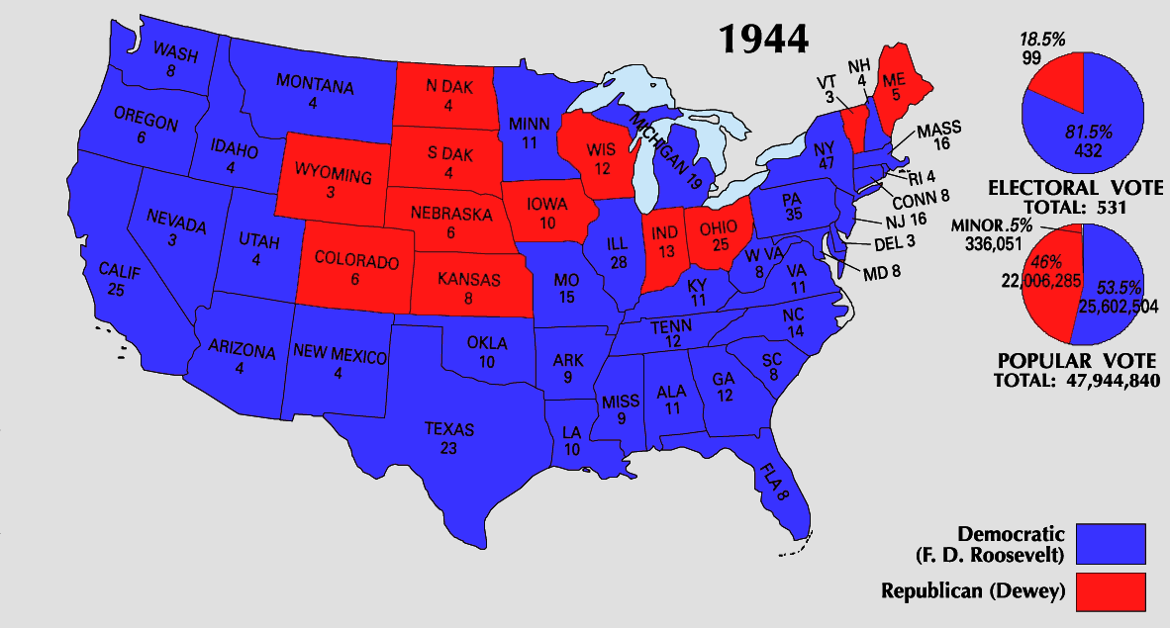
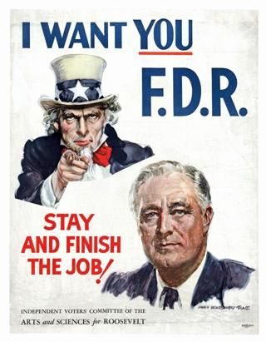
This Date in History
1944: Franklin D. Roosevelt is elected POTUS for the 4th time

Slide 4
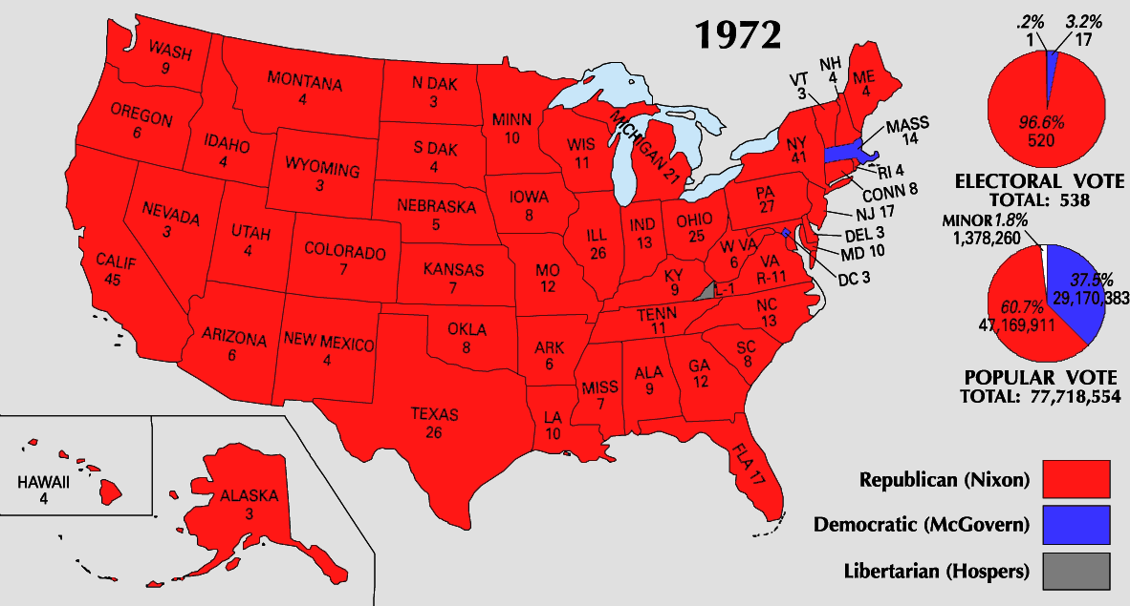
This Date in History
1972: Richard M. Nixon is re-elected

Slide 5
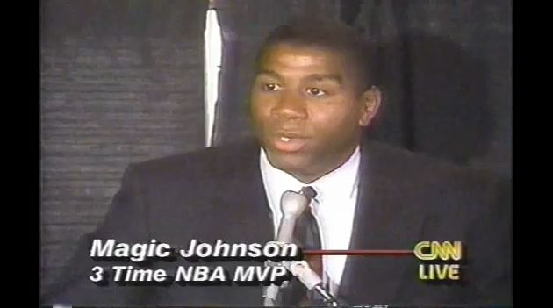
This Date in History
1991: Ervin “Magic” Johnson announces that he has HIV

Slide 6
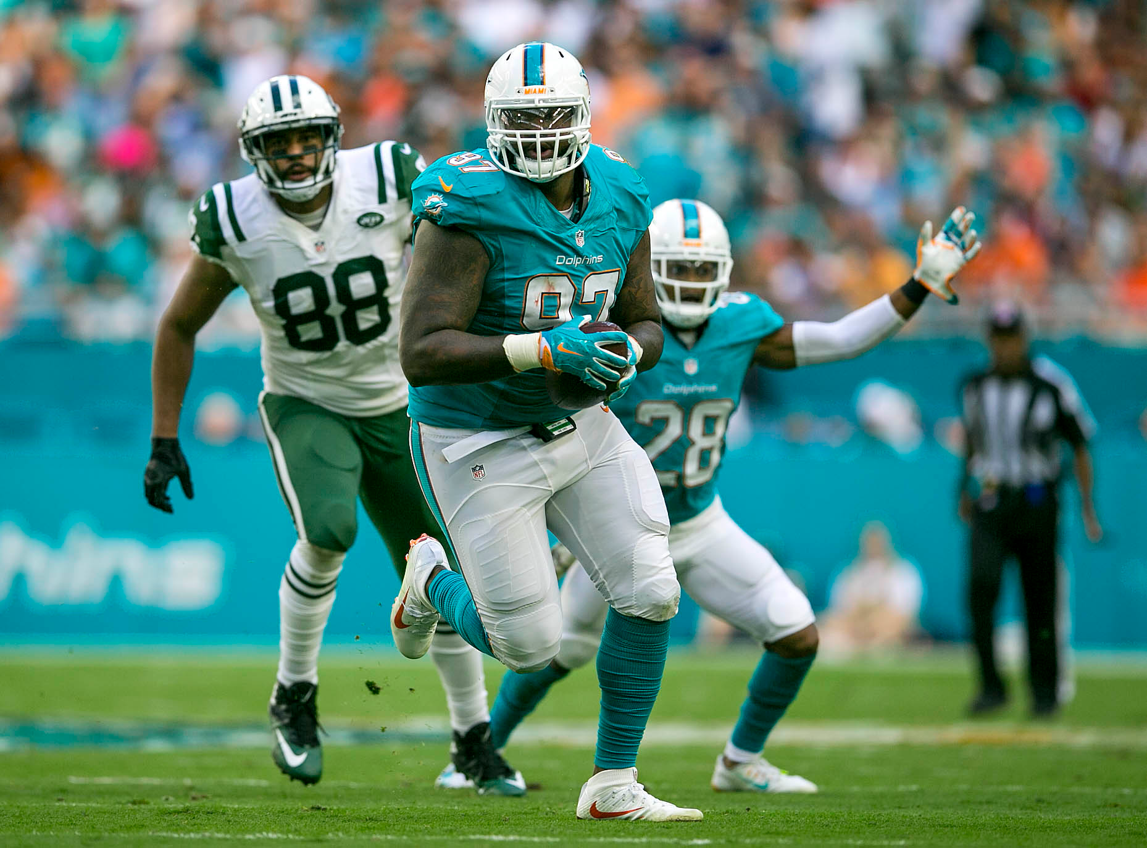
Yesterday in History

Slide 7
Unit Four Review
Washington’s Farewell Address:
Beware of Political Parties
Avoid Foreign Entanglements
Use the U.S. Constitution to solve problems
Do not fall into unsustainable debt

Slide 8
Unit Four Review
Louisiana Purchase:
Spain cedes Louisiana Territory to France
Slave revolt in (Haiti) ruined Napoleon’s plans of expanding his empire into North America
Jefferson sends James Monroe to France to purchase New Orleans and western Florida
Napoleon needs Cash
Sells the entire Louisiana Territory for $15 million
Jefferson believed in a strict interpretation of the Constitution and buying land was not in the Constitution
Jefferson submitted the treaty for Senate approval and it was ratified

Slide 9
Unit Four Review
Harford Convention-Who, What, Why, When AND Where? Meeting of the states MA, CT, RI, NH and VT (New England Federalists) that met in Hartford CT to discuss secession, or sign for separate peace with Great Britain prior to the Battle of New Orleans The group demanded that there be a Constitutional Amendment of a 2/3 Congressional vote before declaring embargos, war or admitting new states They also wanted financial compensation for there economic losses during the War of 1812 The news of the victory in New Orleans ended the meeting and the delegates left

Slide 10
Unit Four Review
What was the purpose of the Embargo Act of 1807?
A law passed by Congress forbidding all exportation of goods from the United States
Passed because of the seizure of U.S. ships by Britain and France
Hurt the U.S. Economy and was repealed in 1809
The Embargo Act helped to revive the Federalists. It caused New England's industry to grow. It eventually led to the War of 1812.

Slide 11
Unit Four Review
Warhawks:
Young congressmen from the Southern and Western states that sought to go to war with Great Britain to solve the Indian problem in the new territories
Strike back at Great Britain due to impressment
Led by Henry Clay (KY) and John C. Calhoun (SC)

Slide 12
Unit Four Review
The Treaty of Ghent was signed on December 24, 1814
Basically an armistice, both sides agreed to stop fighting, return conquered territory, and call the war a draw
Addressed the release of prisoners, a restoration of conquered territory
A commission would be established to settle the disputed northeastern boundary between the US and Canada
What the treaty did not address was impressments, blockades, indemnities, the right for search and seizure, military control of the Great Lakes, or a neutral Indian barrier state b/w the US and Canada (Pretty much everything that caused the war)

Slide 13
Unit Four Review
Nullification (VA/KY Resolutions)
Nullification of acts of Congress that were deemed unconstitutional by the states
Authors – Madison (VA) and Jefferson (KY)

Slide 14
Unit Four Review
Marbury v. Madison:
Established JUDICIAL REVIEW of all acts of Congress and actions of the Executive Branch
Chief Justice John Marshall ruled Congress had overstepped their power
Made the Judiciary Branch an equal partner in the system of Checks and Balances

Slide 15
Unit Four Review
First Political Parties:
Federalists – Wealthy, primarily New England, Loose interpretation of the Constitution
Leaders – Adams, Hamilton
Democratic-Republicans – Farmers, Primarily from the South, Strict interpretation of the Constitution
Leaders – Jefferson, Madison, Monroe

Slide 16
Unit Four Review
Hamilton Financial Plan:
Pay off foreign debt and issue new government bonds to replace those sold during the Revolutionary War and under the Articles of Confederation
Federal Government would assume the debts of the states
Create a National Bank – The Bank of the United States
Issue paper money
Made use of the “Elastic Clause of the U.S. Constitution”
Favored New England Traders and Merchants (Upper Class)

Slide 17
Unit Four Review
Whiskey Rebellion:
Started because Alexander Hamilton sought to impose a tax on “distilled spirits”
Many poor farmers made whiskey from their grain because it was easier to transport and sell
Farmers in Western Pennsylvania refused to pay the tax and rebelled
Hamilton saw this as an opportunity to strengthen the Federal Government by putting down the rebellion
15,000 soldiers led by George Washington and Hamilton went to Pennsylvania
Proved the United States could enforce their laws

Slide 18
Unit Four Review
Jay’s Treaty:
John Jay was in Great Britain to negotiate control of the land west of the Appalachian Mountains
The results of the Battle of Fallen Timbers caused the British to evacuate their posts in the Northwest Territory
Americans in the NW Territory did not like that the British were allowed to continue their fur trade in the United States
U.S. had to pay lingering debts from the Treaty of Paris
Did not solve the problems with British Navy seizing U.S. Ships
Did allow the U.S. to avoid going to war with Great Britain

Slide 19
Unit Four Review
XYZ Affair:
Adams sent three new envoys to meet the French minister Talleyrand: future chief justice John Marshall, Charles Pinckney and Elbridge Gerry to negotiate a solution for the French seizing U.S. ships headed for Great Britain.
Three go-betweens approached the envoys and demanded a loan of 32 million florins and a bribe of $250,000 before they could speak to Talleyrand
President Adams published the documents, in which the three go-betweens were referred to as X,Y, and Z, and the event became known as the XYZ affair
In 1798, Congress created the Department of the Navy
Extreme anti-French sentiment, after the details of the XYZ Affair were published

Slide 20
Unit Four Review
The practice of Impressment:
Capture a ship
Kidnap people and force them to serve in the British Navy

Slide 21
Unit Four Review
War of 1812:
The U.S. lost more than they won:
Great Britain’s superior navy created a blockade of the Atlantic coast
British capture Washington, D.C. and burn it to the ground
There were a great number of battles (land and sea) in the Great Lakes area b/c the British could sail through Canada to the Great Lakes and there were large numbers of Indian tribes that were willing to fight with the British against the U.S.

Slide 22
Unit Four Review
Battle of New Orleans:
Andrew Jackson led a mixed force of @ 7000 men, who were faced by 8000 British troops on January 8, 1815
The result was British suffered over 2000 KIA/WIA’s compared to about 70 US troops
The bad part of the Battle of New Orleans is that the war was over
The Treaty of Ghent was signed on December 24, 1814

Slide 23
Unit Four Review
Adams-Onis Treaty:
under its terms, the United States paid Spain $5 million for Florida
Spain recognized America's claims to the Oregon Country
The United States surrendered its claim to northern Mexico (Texas)

Slide 24
Unit Four Review
Judiciary Act of 1789:
Established the Supreme Court
Built Federal Court system
Added the position of Attorney General

Slide 25
Unit Four Review
Pinckney’s Treaty:
Spain feared that the U.S. and Great Britain would combine to take the Louisiana Territory from Spain
Spain ceded the Louisiana Territory to France in 1800 with the Third Treaty of San Ildefonso
Spain gave up all claims to land east of the Mississippi River
Recognized the 31st parallel as the U.S. – Spanish boundary of Florida
Opened the Mississippi River to U.S. travelers
Allowed American Traders to use the Port of New Orleans

Slide 26
Unit Four Review
Burr Conspiracy:
Kills Hamilton in a duel
Flees to Southwest
An effort to capture Spanish possessions in the Southwest or to engineer the secession of western states from the Union
Brought to trial (Conducted by Chief Justice John Marshall) who ruled that conspiracy to commit treason is not same as the overt act of treason: Burr was acquitted

Slide 27
Unit Four Review
Abigail Adams:
Leading voice for women’s rights
Pushed for women’s suffrage

Slide 28
Unit Four Review
U.S. Electorate in 1820:
White Males
Lawful age
Property owners
Property qualifications were steadily being lowered

