Slide 1
Warm-Up 5OCT18
Which European nation brought in the most slaves as a result of the Atlantic Slave Trade?

Slide 2
Warm-Up 5OCT18
Which European nation brought in the most slaves as a result of the Atlantic Slave Trade?
Portugal to Brazil – 3.6 million slaves

Slide 3
Warm-Up 5OCT18
What were the first attempts to abolish slavery in America?

Slide 4
Warm-Up 5OCT18
What were the first attempts to abolish slavery in America?
Thomas Jefferson, owning over one hundred slaves himself, Jefferson frequently spoke out against the enslavement of African-Americans, and included a passage in his Declaration that would make slavery impossible in the new United States of America.
Hypocrisy of how slavery was wrong, but the economy and the South was reliant on slave labor

Slide 5
ACTIVITY
WHERE TO | HOW MANY | FROM WHERE
BRITISH NORTH AMERICA
BRITISH CARIBBEAN
FRENCH CARIBBEAN
DUTCH CARIBBEAN
SOUTHWEST ASIA
SPANISH AMERICA
BRAZIL

Slide 6
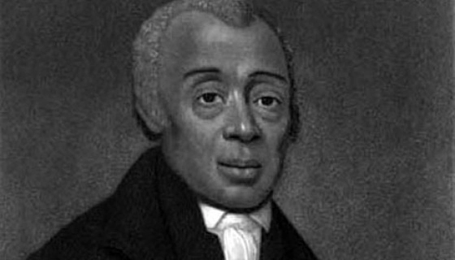
This Date in History
1830: First National Black convention met at Philadelphia's Bethel AME church and elected Richard Allen president. Thirty-eight delegates from eight states attended the first national meeting of Blacks.

Slide 7
Warm-Up 9OCT18
How were slaves divided in the Caribbean?

Slide 8
Warm-Up 9OCT18
How were slaves divided in the Caribbean?
Slaves were divided into three categories
Creoles – slaves born in Americas
Old Africans – slaves who had lived in the Americas for quite some time
New Africans – slaves who had just survived the Middle Passage

Slide 9
Warm-Up 17OCT18
How did Native Americans adapt to the incursion of Europeans and Africans into their traditional homelands on the east coast of North America?

Slide 10
Warm-Up 17OCT18
How did Native Americans adapt to the incursion of Europeans and Africans into their traditional homelands on the east coast of North America?
Occasionally Native Americans provided refuge for escaped slaves
Other times Native Americans became slaveholders and helped Europeans crush slave revolts
Some Blacks were involved in the Native American slave trade
Blacks also helped defend European settlements from Native American attacks
Native Americans and Blacks both found themselves the victims of European oppression

Slide 11
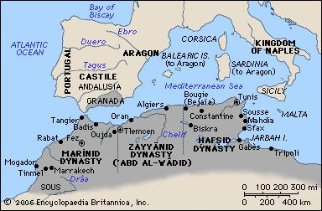
Origins of the African Slave Trade
Motivating Factors:
Find allies in Africa to spread Christianity and combat the spread of Islam
Establish trade with the African kingdoms
Primary Reason – Faster route and expansion of trade with China, India, Japan and Southeast Asian Island nations

Slide 12
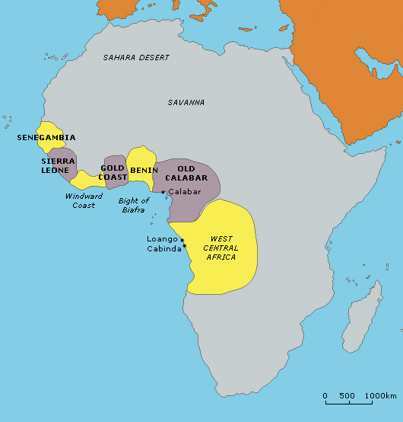
Origins of the African Slave Trade
Slavery in Africa prior to European arrival:
The kingdoms of Senegambia, Benin and Kongo were all involved in the capture and sale of White, Mixed and African slaves
Main Source was from warfare

Slide 13
Origins of the African Slave Trade
Islamic slave trade compared to Atlantic slave trade:
Islamic slave trade: Sudanese horsemen captured primarily women and children that would be concubines and servants in North Africa and SW Asia
Men who were captured were used as soldiers
Atlantic slave trade sought young men for agricultural labor
Destined for British, French and Spanish colonies in the new world

Slide 14
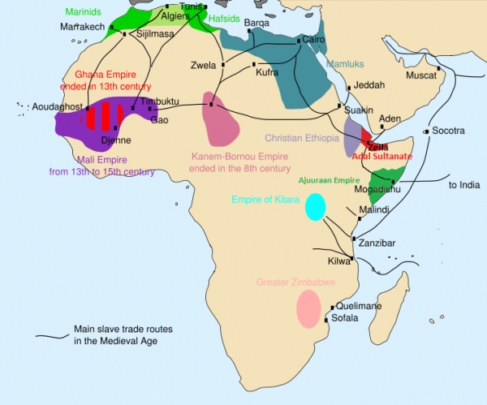
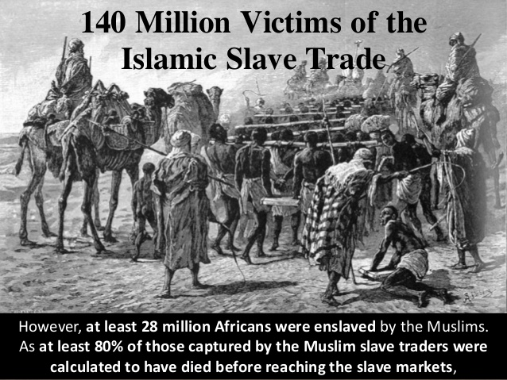
Origins of the African Slave Trade

Slide 15
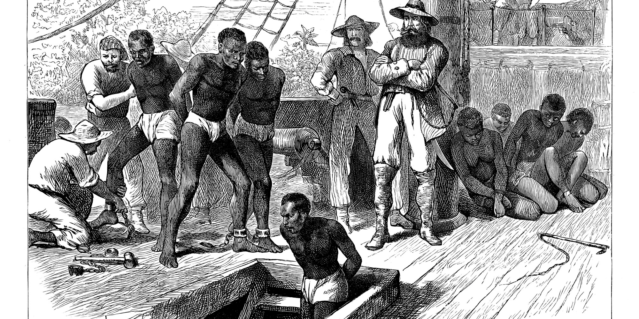
Origins of the African Slave Trade

Slide 16
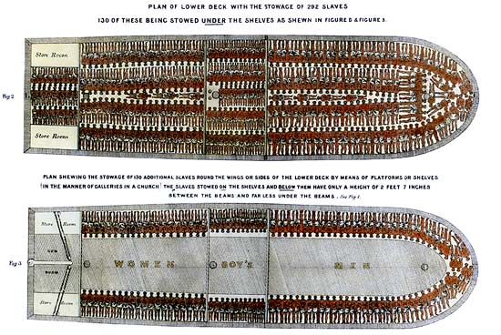
Origins of the African Slave Trade

Slide 17
Origins of the African Slave Trade
Origins of the Atlantic slave trade:
Portuguese raiders captured West Africans as servants in Portugal and Spain
This would change significantly as Europeans began to purchase slaves from African traders
The existing trade and slave infrastructure of African kingdoms and the European desire for slave labor would lead to the initial formation of the Triangle Trade System
Rivalries and warfare in West Africa was the source of slaves to be sold to Europeans

Slide 18
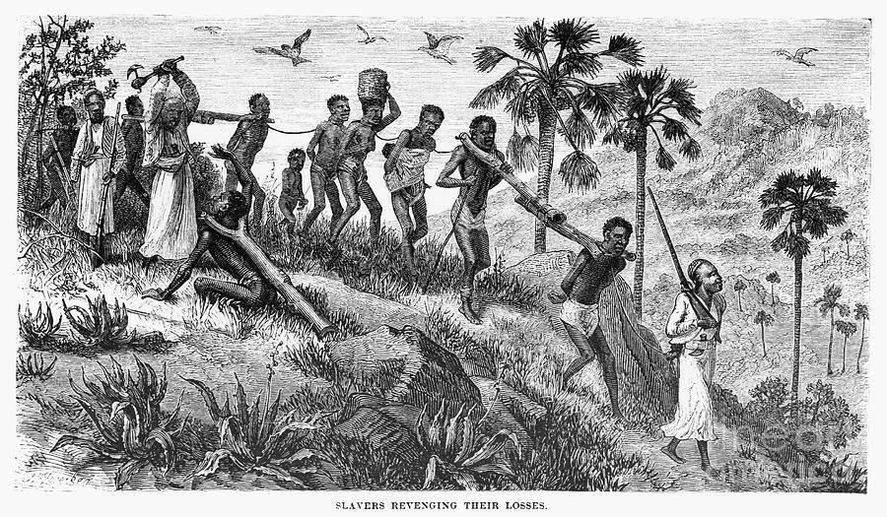
Origins of the African Slave Trade

Slide 19
Origins of the African Slave Trade
Origins of the Atlantic slave trade:
Columbus’ discovery of the New World changed the desire for slave labor dramatically
The nations of England, France, Spain, Portugal and the Netherlands were all racing to establish colonial dominance in the New World

Slide 20
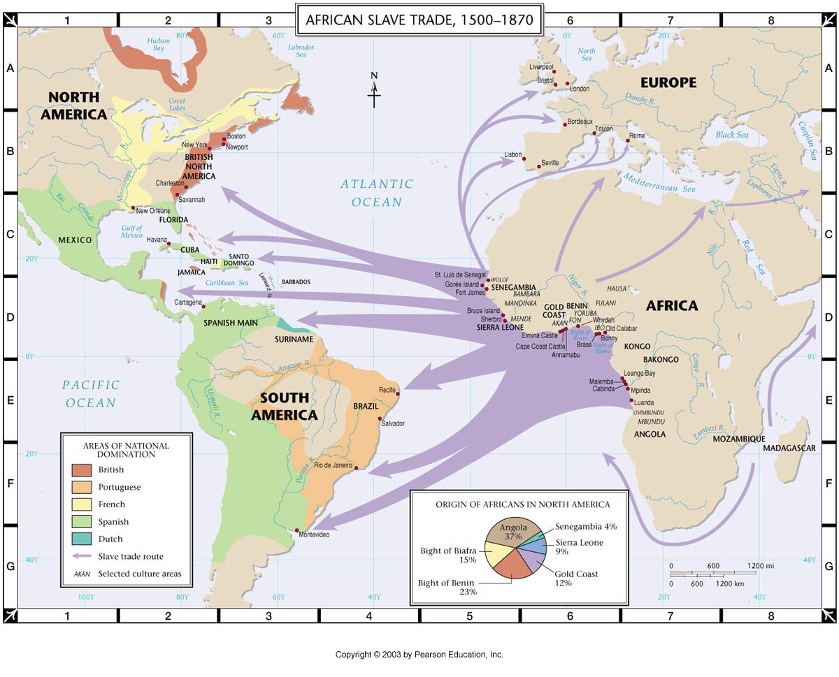
Origins of the African Slave Trade

Slide 21
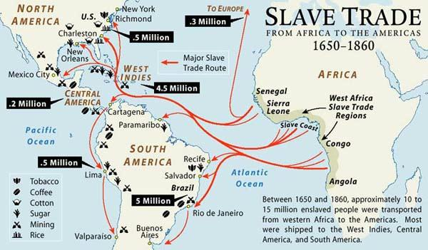
Origins of the African Slave Trade

Slide 22
Origins of the African Slave Trade
Destinations for the slave trade:
The new wealth created by expanding agricultural markets fueled the need for slaves
Sugar plantations in the West Indies
Rice, Tobacco and Indigo in North America
The term “chattel” is defined as personal property, and those sold into slavery lost their basic rights as human beings
In the 18th century, John Locke would write that the “Natural Rights of Man were Life, Liberty and Property”

Slide 23
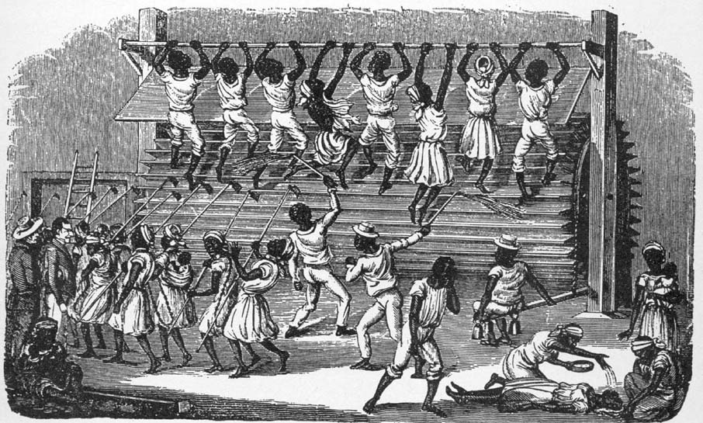
Origins of the African Slave Trade

Slide 24
Origins of the African Slave Trade
African Men and boys were sold into slavery due the European belief that they were stronger laborers
Women were preferred as agricultural by West Africans and were withheld from the slave trade
As slavery grew in the New World, the practice of breeding the strongest men with the strongest women to produce more slaves led to an increase in women being sold into slavery

Slide 25
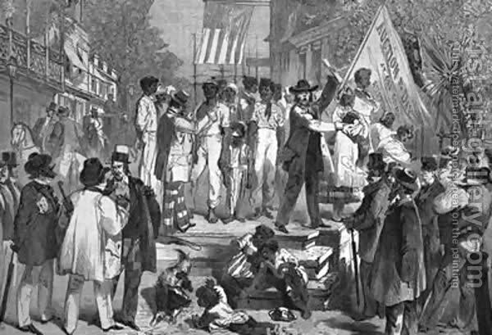
Origins of the African Slave Trade

Slide 26
Origins of the African Slave Trade
England becomes the leader of the Atlantic Slave Trade:
England defeated the French and Spanish in The War of Spanish Succession (1713) and drove the Dutch out of slave trade in the late 17th century
The English took control of the Asiento (contract) for the Atlantic slave trade as a result of their victory
Transported approximately 20,000 slaves per year
During the 1790’s, the English were transporting 50,000 slaves per year
WHY INCREASE IN THE 1790’S

Slide 27
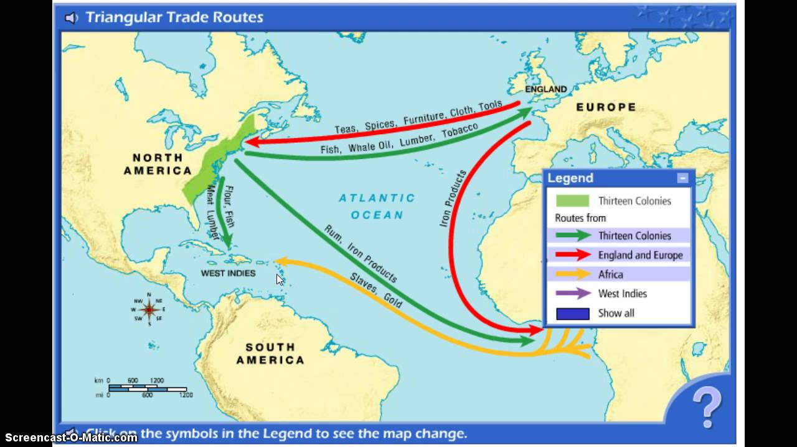
Origins of the African Slave Trade

Slide 28
Origins of the African Slave Trade
Expanding states and kingdoms in West Africa and the warfare between them made slaves available for sale/trade
Nation-states and kingdoms included
Senegambia
Sierra Leone
Oyo
Dahomey
Benin
Kongo
Europeans traded guns for slaves
Those sold included POWs, raided villages and isolated families

Slide 29
Origins of the African Slave Trade
Slaves were often held in “factories” for weeks/months
After being sold they were placed on “slavers”
The Middle Passage was route followed by Columbus from the Canary Islands to the West Indies
Voyage was two-three months
Light-packers v. tight packers
Slaves were packed in areas 5.5 feet long and 1.3 feet high
Slaves were shackled and separated to prevent revolts
Conditions were unsanitary and led to epidemics
Flux, dysentery, malaria, scurvy, smallpox

Slide 30
Origins of the African Slave Trade
John Newton was an indentured servant who served out his contract and became a slaver
After surviving storm on the return to England, he became an Evangelical Christian
Despite his conversion, he was a harsh slaver who would eventually captain his own ship
He retired because of health
After retirement, Newton became an Anglican priest and repented from his involvement with the slave trade
Became a leading abolitionist voice in the 1770’s

Slide 31
Origins of the African Slave Trade
Slaves aboard ships were fed twice per day
Pulps, porridge and stews were distributed in buckets to the slaves
Many slaves had to eat with their hands (unwashed) which led to the spread of disease
Slavers brought less food for slaves to increase the numbers that they could pack onto the ships
Many slaves died from disease, malnutrition or starvation

Slide 32
Origins of the African Slave Trade
Diseases aboard slavers
Malaria
Measles
Smallpox
Hookworm
Scurvy
Dysentery (Flux)
Four toilet tubs that were used by the confined slaves
Slaves often excreted where they lay in the shelves
Surgeons were unfamiliar with germs and hygiene and were of little to no help in keeping slaves healthy

Slide 33
Origins of the African Slave Trade
Surgeons – in search of bonuses for the number of slaves that arrived at their destination in health sought:
Herbs and food from along the Guinea Coast in order to use African practices and medicine for the health of the slaves
Africans believed that their were evil spirits aboard the slavers and sought to perform rituals to save themselves

Slide 34
Origins of the African Slave Trade
Revolts onboard the slavers:
Revolts were most likely to occur while the ships prepared to set sail and Africans could still see the coast
Many Africans refused to accept slavery and revolted at sea
There was little chance of overthrowing the ship and returning to Africa
Many Africans preferred death over slavery

Slide 35
Origins of the African Slave Trade
The slave quarters were much smaller:
Europeans were not inclined to treat Africans with the same value of human life as they would other Europeans
Food, medicine and sanitation were sub-human
European slavers cared little about the physical and emotional abuse that they inflicted upon the Africans

Slide 36
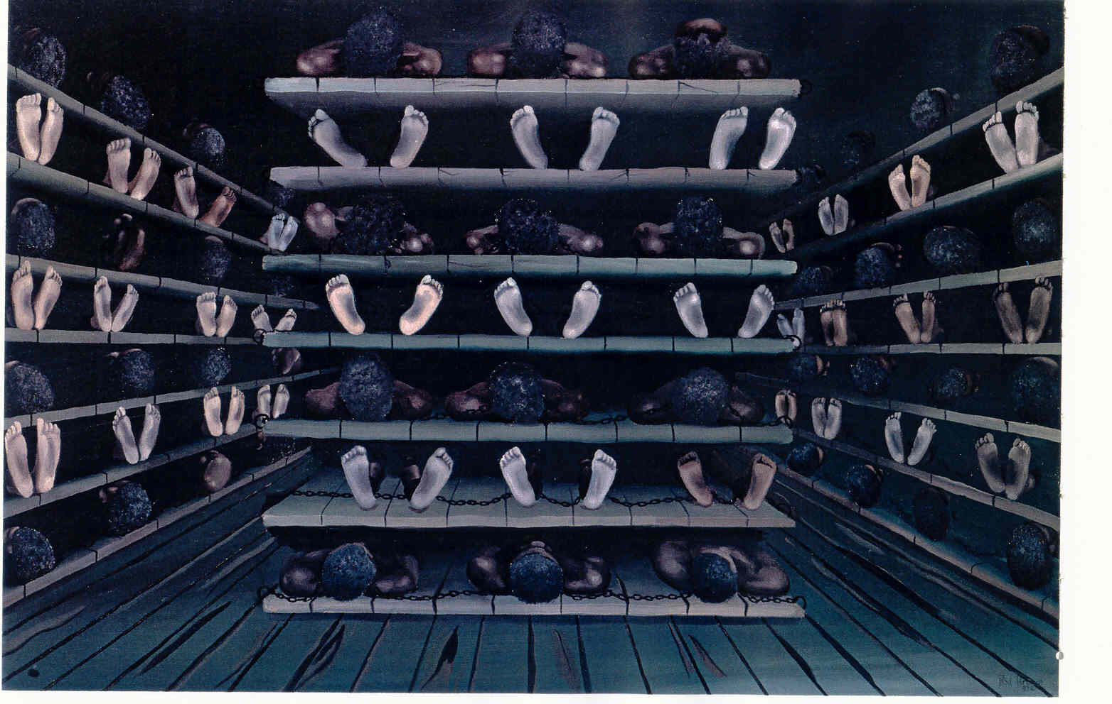
Origins of the African Slave Trade

Slide 37
Origins of the African Slave Trade
African Women on slave ships
Sailors physically and sexually abused African women
Women only brought half the price of men at slave auctions
African women were separated from African men during the voyage, which made it easier for sailors to abuse them

Slide 38
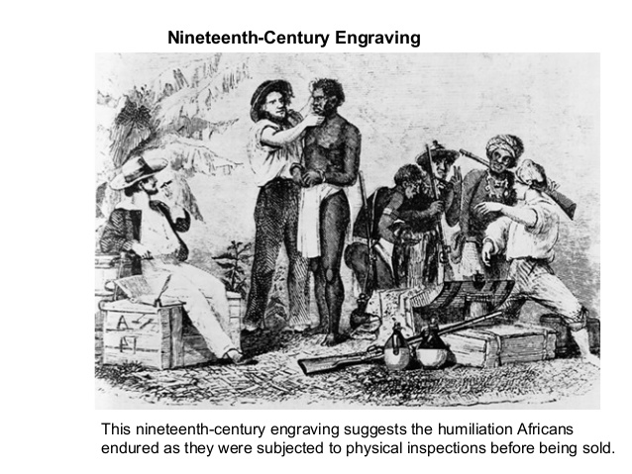
Origins of Slavery
Actions prior to Auction:
Aside from exercise and bathing
Dyed hair to cover up age
Oiled slaves’ bodies to cover blemishes, rashes and bruises
Took measures to hide dysentery and flux

Slide 39
Origins of Slavery
Different types of Slave Auctions:
Port-to-Port: Ship captains determined whether to sell entire cargo at one port or multiple ports based on profit
Individual: Slaves were individually to maximize profit
Lot: Sell slaves as a group for one price
Scrambles: Slaves were placed in an area and buyers would rush in to grab the ones that they wanted

Slide 40
Origins of Slavery
Three Categories of Slaves
Creoles – slaves born in Americas
Old Africans – slaves who had lived in the Americas for quite some time
New Africans – slaves who had just survived the Middle Passage

Slide 41
Origins of Slavery
Seasoning Process: Conditioning and Assimilating new slaves into the slave culture
An apprenticeship in the West Indies to condition slaves to a work routine
This was often to prepare slaves for resale in North America
Started with giving slaves a “Christian” name
Learning a European language - Gullah

Slide 42
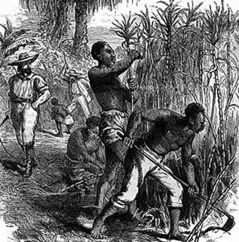
Origins of Slavery
Gangs:
Great Gang: Strongest men used for planting and harvesting
Second Gang: Women and older men used for light field work
Third Gang: Children worked shorter hours bringing food and water to the field workers
House servants: Typically light-skinned to work in the “Big House”

Slide 43
Origins of Slavery
Slaves could earn their freedom:
Through their own industry of planting garden plots for sale
Trapping
Fishing
Earn enough to buy a horse or mule to expand their garden or breed for sale

Slide 44
Origins of Slavery
Seasoning Criterion:
Survival after being purchased
Adapt to food and weather
Food – Salted codfish from New England, corn, squash
New language – speak local language or Creole dialect well enough to obey commands
Psychological – After suicide thoughts passed, planters assumed that a slave had accepted their captivity and status
Many slaves imported from Africa kept portions of their culture and heritage - DISCUSSION

Slide 45
Origins of Slavery
End of the Atlantic Slave Trade:
English abolitionists movement began in the late 1700’s
England’s economy was less reliant on slave labor
Shift in England towards industrialization
England abolishes the slave trade in conjunction with the ban on the importation of slaves into the United States in 1808 (Commerce and Slave Trade Compromise) which was part Constitutional Convention – more to follow

Slide 46
Slavery in the New World
Spanish Melting Pot:
Africans and Indians were sometimes able to gain freedom and take on jobs within Spanish colonial society
The customs of each group mixed and melded into a unique new culture
Examples include Cuba, Dominican Republic and Puerto Rico

Slide 47
Slavery in the New World
British become the Unilateral Superpower:
Victory over the Spanish Armada in 1588
Establish first North American colony in Jamestown in 1607
Tobacco, Rice and Indigo become MAJOR CASH CROPS
Strong English navy/pirates victimize and raid Spanish ships
Wealth of raw materials from North America build England’s Triangular Trade and system of mercantilism

Slide 48
Slavery in the New World
British and Spanish differ on slavery:
The Spanish immediately resorted to slave labor; first the Native Americans and then African slaves to cultivate sugar
The British saw their colonies as a solution to unemployment and sought send undesirables to North America
Relied on Indentured Servants to provide labor

Slide 49
Slavery in the New World
First Africans to Jamestown:
The first Africans arrived as domestic servants for English who had immigrated to America
The first group of Africans that were traded in the British colonies of North America were the result of a raided Portuguese ship carrying a human cargo from Angola

Slide 50
Slavery in the New World
Unfree v. Slave
The British had no laws governing slavery
Those who were taken from the Portuguese ship had been converted to Christianity
In accordance with British law, no Christians could be enslaved
The Africans worked off their purchase price and gained their freedom

Slide 51
Slavery in the New World
Chattel Slavery begins in the English Colonies:
Africans were largely treated as indentured servants prior to the 1670’s
The Africans in the English colonies were such a distinct minority that they took on the status of “alien” among the wealthier colonists
The wealthy planters shifted their concept of using Africans as Indentured servants to the status of property, thus the transition to “chattel slavery”

Slide 52
Slavery in the New World
Headright System: Planters in VA and MD would be awarded 50 acres of land for every laborer they imported as an Indentured Servant. Those who agreed to be indentured servants would have their fare paid across the Atlantic, room and board and were typically promised a small sum of money and a plot of land when their contract was fulfilled.

Slide 53
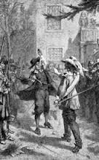
Slavery in the New World
In 1676, Nathaniel Bacon, a Virginia planter, led a group of 300 settlers in a war against the local Native Americans. When Virginia's royal governor questioned Bacon's actions, Bacon and his men looted and burned Jamestown. Bacon's Rebellion manifested the increasing hostility between the poor and wealthy in the Chesapeake region.
STOP

Slide 54
This Date in History
1829: David Walker of Massachusetts wrote his fiery tract The Appeal. Its eloquence and uncompromising defiance was a source of great inspiration to African people, free and slave, as well as cause for alarm for Southern slave owners and many Northern abolitionists who favored more gradual change

Slide 55
AGENDA 28SEP18
Review Study Guide Questions
Turn in Warm-Ups 24-28SEP18
Turn in Guided Notes from Unit 2 – Parts 1/2
Quiz – Unit 2 Part 2
Return graded work
Roots – Run and search for Fanta

Slide 56
Origins of the African Slave Trade
Destinations for the slave trade
1.25 Million to SW Asia
3.6 Million to Brazil
1.25 Million to North Africa
1.075 Million to Spanish South America
4.0 Million to the West Indies
200K to Mexico
400 K to British colonies in present day United States

