Slide 1
Warm-Up 25 OCT 16
What three reasons did George III give for issuing the Proclamation of 1763?
How did Great Britain propose to pay off the debt incurred from the French-Indian War?

Slide 2
Warm-Up 25 OCT 16
What three reasons did George III give for issuing the Proclamation of 1763?
The border was too long to defend and it would cost too much
Great Britain was broke
Great Britain still had a lucrative fur trade with the Indians
How did Great Britain propose to pay off the debt incurred from the French-Indian War?
Series of revenue-raising taxes levied against the colonies

Slide 3
Mid-Term Review
Three colonial regions
New England – Rocky soil, short growing season, focused on trade
Middle – hybrid of New England and Southern colonies, provided grain, beef and possessed natural harbors and water transportation system
Southern – Fertile soil, long growing season, possessed natural harbors and water transportation system

Slide 4
What Motivated Europeans to Explore?
Wanted to expand trade by:
Finding New Goods
Raw materials (gold, silver, spices, etc.)
Creating New Markets
(new people to trade with)
Establishing New Trade Routes
Faster/more efficient routes to Asia
Spice and silk trade
More Trade=More Wealth=More Power!!!!

Slide 5
What made exploration possible?
New Technology
Compass – navigation tool for finding direction on the ocean
Gunpowder – military advantage for subduing native peoples
Astrolabe – navigation tool using the stars to locate ones’ position in the ocean
Caravel (ship) – hull design and sails allowed ships to sail the oceans
Cartography – map making improved

Slide 6
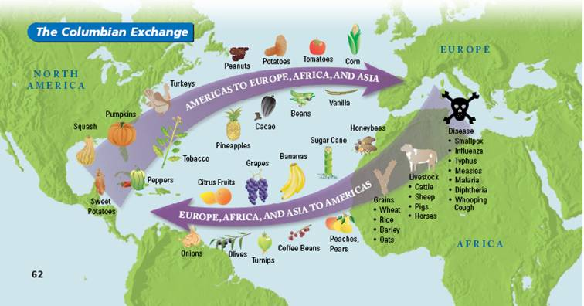
Columbian Exchange
NEGATIVES:
Disease
Increase in slave trade

Slide 7
Midterm Review
Jamestown Colony, Virginia 1607
1st permanent British settlement in North America
Chartered by King James I
Funded by the Virginia Company (Joint Stock Company)
Purpose of the Colony: Make Profits!!!! (expected to find silver, gold, precious resources)
Plymouth
Established in 1621 and founded by the Pilgrims
group of religious dissenters who were granted a charter to begin a colony
Sought religious freedom
Sought to permanently relocate with family to practice their religion free from discrimination

Slide 8
Colonial Economics
Mercantilism: Colonies existed to benefit the “Mother Country” by
providing raw materials for industry
providing a captive market for Mother’s finished goods
contribute to the wealth of the Mother Country
“Do not compete with Mother in terms of buying or selling to other countries”

Slide 9
Colonial Economics
Navigation Acts: Passed under the mercantilist system, the Navigation Acts (1651-1673) regulated trade in order to benefit the British economy. The acts restricted trade between England and its colonies to English or colonial ships, required certain colonial goods to pass through England before export, provided subsidies for the production of certain raw goods in the colonies, and banned colonial competition in large-scale manufacturing.

Slide 10
Political Evolution of the Colonies
Magna Carta:
The king is not the absolute ruler, but is subject to the laws
All persons are guaranteed a trial by jury
Only Parliament can levy/collect taxes
Virginia House of Burgesses:
the first legislative assembly of elected representatives in North America
established by the Virginia Company
Its first meeting was held in Jamestown, VA on July 30, 1619

Slide 11
Political Evolution of the Colonies
Mayflower Compact (1620):
The first governing document of Plymouth Colony
It was drafted during the voyage to North America
English Petition of Rights (1626): Parliament declares the basic rights and liberties of the people:
that no freeman should be forced to pay any tax, loan, or benevolence, unless in accordance with an act of parliament

Slide 12
Colonial Economics
Headright System: Planters in VA and MD would be awarded 50 acres of land for every laborer they imported as an Indentured Servant. Those who agreed to be indentured servants would have their fare paid across the Atlantic, room and board and were typically promised a small sum of money and a plot of land when their contract was fulfilled.

Slide 13
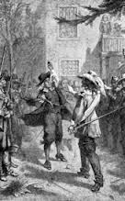
Colonial Economics
In 1676, Nathaniel Bacon, a Virginia planter, led a group of 300 settlers in a war against the local Native Americans. When Virginia's royal governor questioned Bacon's actions, Bacon and his men looted and burned Jamestown. Bacon's Rebellion manifested the increasing hostility between the poor and wealthy in the Chesapeake region.

Slide 14
Warm-Up 7SEP16
What was the ultimate result of Bacon’s Rebellion?
Switch from indentured servants to African slaves; huge increase in importation of slaves

Slide 15
Natural Rights
Rights that are so basic they cannot be taken away
John Locke - LIFE, LIBERTY, PROPERTY from Second Treatise Concerning Civil Government written in 1690
Advocated Checks and Balances
Rule of Law
Representative Government
Declaration of Independence - LIFE, LIBERTY, PURSUIT OF HAPPINESS

Slide 16
Warm-Up 6SEP16
The slave trade route from West Africa to the West Indies and North America was called _____________.
The Middle Passage

Slide 17
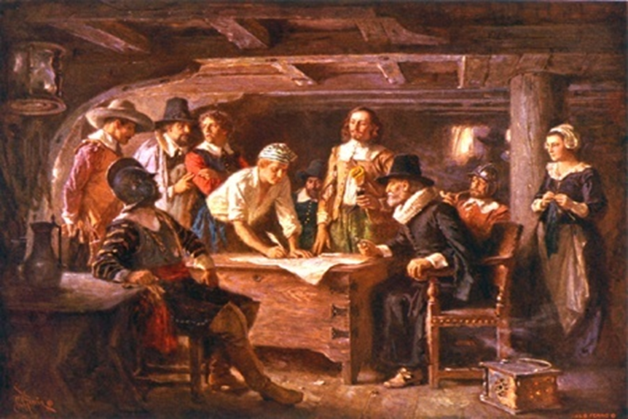
Mayflower Compact
Social Contract of the PILGRIMS
Created in 1620
Became the foundation of law at the Plymouth colony in Massachusetts
Established the idea of self-government in the colonies

Slide 18
Maryland’s Acts of Toleration
Lord Baltimore was granted a charter in the New World and founded a colony for Catholics.
England was a protestant nation and Catholics were not welcomed.
In 1649, the Maryland legislature passed the Acts of Toleration which allowed both Protestant and Catholics to freely practice their religion. This was a major milestone for religious freedom in America

Slide 19
Seeds of the 1st Amendment
John Paul Zenger The New York Weekly Journal. The first generation of American editors discovered readers loved it when they criticized the local governor; the governors discovered they could shut down the newspapers. The most dramatic confrontation came in New York in 1734, where the governor brought Zenger to trial for criminal libel after the publication of satirical attacks. The jury acquitted Zenger, who became the iconic American hero for freedom of the press.

Slide 20
Colonial Indian Wars
1st Powhatan War (1610-1614)
WHAT CAUSED IT? Lord De La Warr and other English leaders were seeking additional land
OUTCOME? Powhatan’s daughter, Pocahontas marries John Rolfe to signal a truce

Slide 21
Colonial Indian Wars
King Philip’s War
Who: The New Englanders, the Wampanoag's, the Narragansett's, and other Native American Indian tribes
What: Conflict between the New Englanders and the nearby Native American Indians sparked by the English encroachment on native land
When: 1675-1676
Where: New England Colonies
Why: New England colonists were running out of land, hence land prices were going up. Poorer citizens disliked this and wanted to expand into native land as it was cheaper.
Outcome: Extermination of Indians in New England, undeterred expansion

Slide 22
Colonial Indian Wars
Queen Anne’s War:
WHAT CAUSED IT? Colonial version of the War of Spanish Succession (1702-1713) (England, Germany and the Netherlands vs. Spain and France to control trade in the New England region

Slide 23
English Bill of Rights
King William and Queen Mary accepted this document in 1689. It guaranteed certain rights to English citizens and declared that elections for Parliament would happen frequently. By accepting this document, they supported a limited monarchy, a system in which they shared their power with Parliament and the people

Slide 24
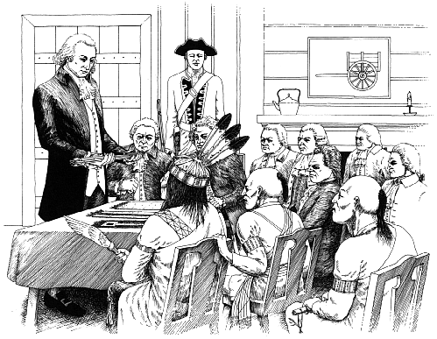
The Albany Congress
Plan of Benjamin Franklin to unite the colonies and the Iroquois nation to fight against the French
Seven colonies attended, but none ratified the plan once they returned to their colonies

Slide 25
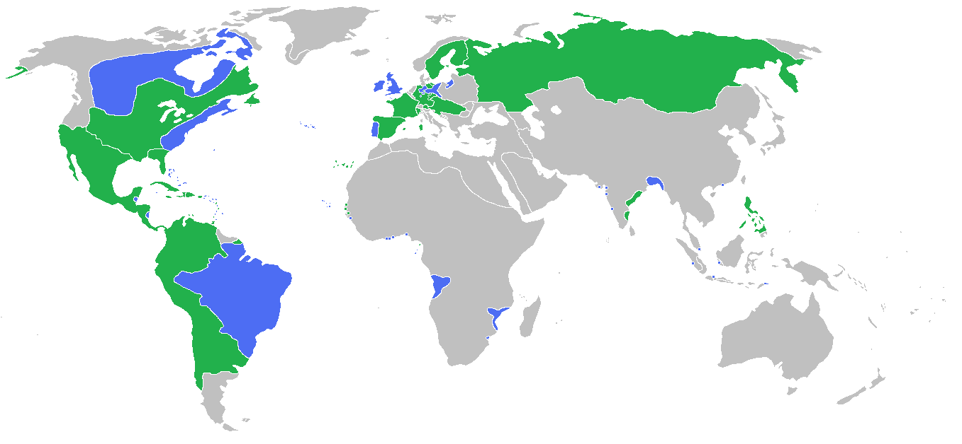
Political Evolution of the Colonies
French and Indian War (1756-1763)
a war in North America between France and Britain (both aided by Indian tribes)
Turned into the worldwide Seven Years' War
ENGLISH AND THEIR ALLIES – BLUE
FRENCH AND THEIR ALLIES - GREEN

Slide 26
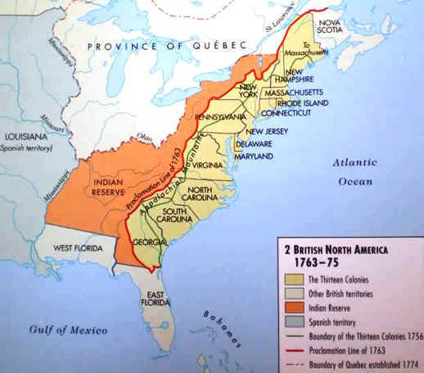
Political Evolution of the Colonies
Proclamation of 1763: George III forbade colonists from settling west of the Appalachian Mountains. WHY?

Slide 27
Political Evolution of the Colonies
Main British Taxation Acts:
Sugar Act – 1764
reduced taxes on sugar and molasses, but enforced the Navigation Act

Slide 28
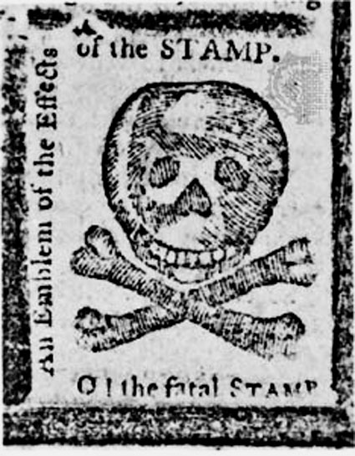
Political Evolution of the Colonies
Main British Taxation Acts: Stamp Act (1765)
Required colonist to purchase stamps on legal documents, such as, wills, deeds, mortgages, playing cards, newspapers, wedding licenses, and death certificates.

Slide 29
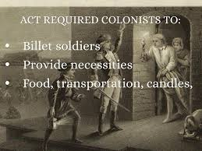
Political Evolution of the Colonies
Main British Taxation Acts:
Quartering Act – 1765
Colonists were required to provide food and shelter for British troops assigned to that area.

Slide 30
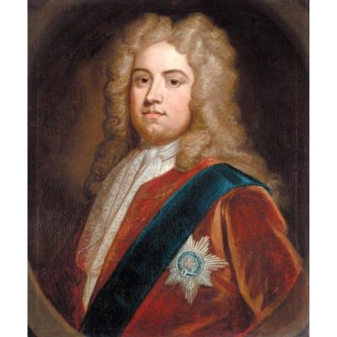
Political Evolution of the Colonies
Main British Taxation Acts:
Townshend Acts (1767)
Taxes on glass, paint, oil, lead, paper, and tea were applied with the design of raising £40,000 a year for the administration of the colonies.
Boston was later occupied by British troops
Bostonians, and then the rest of the colonies began to boycott British goods

Slide 31
Political Evolution of the Colonies
Patrick Henry
Made a dramatic speech to the Virginia House of Burgesses in May 1765. "Virginia Resolves" were his resolutions for the colonies on taxes. No taxing unless by the Virginia House.

Slide 32
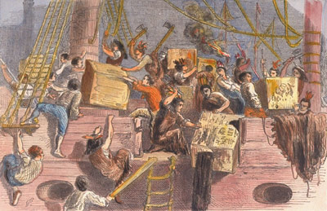
Political Evolution of the Colonies
Main British Taxation Acts:
Tea Act (1773) gave East India Company a monopoly on tea imports to America.

Slide 33
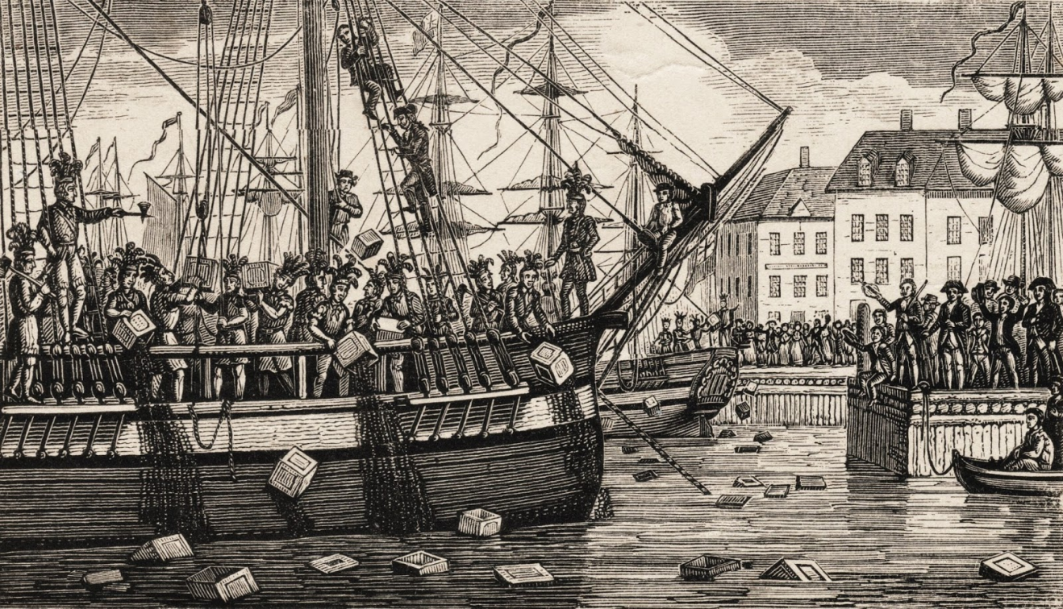
Political Evolution of the Colonies
Boston Tea Party - 1773
When tea came from Britain, many people wanted the tea to get sent back, so a group of men disguised as Indians, boarded the ship and dumped all the tea in the harbor
Reported damage:
£9,659; equivalent to $1,700,000 in today’s money

Slide 34
Political Evolution of the Colonies
Main British Taxation Acts:
Coercive Acts (1774) - In Great Britain, these laws were referred to as the Coercive Acts. The acts took away Massachusetts' self-government and historic rights, triggering outrage and resistance in the Thirteen Colonies. They were key developments in the outbreak of the American Revolution in 1775.

Slide 35
Political Evolution of the Colonies
Lexington and Concord (April 1775): British commander in Boston sends troops to capture John Hancock and Samuel Adams and seize weapons and ammunition in Lexington, MA. First shot of the Revolutionary War is fired at Lexington. Colonists employ guerrilla tactics to harass and kill British troops on their march back to Boston.

Slide 36
Political Evolution of the Colonies
Common Sense by Thomas Paine (1776): arguing for American independence from Britain. In England he published The Rights of Man

Slide 37
American Advantages
Home field
Agriculturally self-sufficient
Better marksmen
Geographic expanse
No key city that was captured could lead to their downfall
Defensive fight 3:1
Strong military leadership
International support
Strong diplomatic corps
Fighting for a just cause

Slide 38
American Disadvantages
Unorganized military
High desertion rate
Loyalists within the colonies (Tories)
Lack of financial support
6 month enlistments
Very little formal training
Heavy reliance on the militia
Economic treason – selling supplies to the enemy

Slide 39
British Advantages
Well-organized, well-trained military
$ to hire mercenaries
Strong Navy
Deep pockets
Experienced soldiers

Slide 40
British Disadvantages
Unilateral Superpower
Distance
Poor Leadership
Mistreatment of POWs
Lack of Conviction
Colonial problems elsewhere…Ireland, India

Slide 41
The Tide Turns
The British captured the United States capital in Philadelphia in the fall of 1777
George Washington and his army retreat to spend the winter at Valley Forge, PA
The Key American Victory was at the Battle of Saratoga
This victory would encourage the French to enter into the war and help the Americans

Slide 42
Siege of Yorktown September 28, 1781 - October 19, 1781
(October 19, 1781; Last major battle of the Revolutionary War) American troops under George Washington and Comte de Rochambeau trapped British troops under Charles Cornwallis and his troops in the Chesapeake Bay, with the help of Admiral de Grasse and the French fleet. Cornwallis was forced to surrender. Significance: although not the last of the fighting, this signified the end of the war.

Slide 43
Political Evolution of the Colonies
First Continental Congress (1774)
All colonies but Georgia went to this Congress in Philadelphia in 1774 to determine how the colonies should react to what, from their viewpoint, seemed to pose an alarming threat to their rights and liberties; no talk of secession from England, just wanted to protest parliamentary acts and restore the relationship they had with Britain before the French and Indian War

Slide 44
Political Evolution of the Colonies
Declaration of Independence: the document recording the proclamation of the Second Continental Congress
(4 July 1776) asserting the independence of the colonies from Great Britain
-Who were the Primary influences on Jefferson’s writing of the Declaration of Independence? ____________________________

Slide 45
Warm-Up 22SEP15
What happened to those who supported the British in America after the Revolutionary War ended?
A great deal of fighting between Patriots and Loyalists continued in the South after the war.
Many Loyalists followed the British soldiers to other parts of the British Empire.
Approximately half of the Loyalists moved to Canada and settling in Nova Scotia

Slide 46
Treaty of Paris – Terms
The American Revolutionary War was formally ended
The British acknowledged the independence of the United States
The colonial empire of Great Britain was destroyed in North America
U.S. boundaries were established

Slide 47
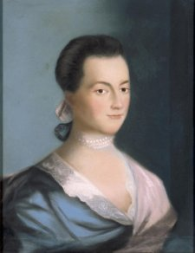
Abigail Adams presses for Change
Married her 3rd cousin – John Adams
Provided care for soldiers during the American Revolution
Wrote over 1,000 letters to her husband during his travels as an ambassador for the United States
During the Revolution, she was assigned by the Massachusetts Court to question other women’s loyalty
Survived the Smallpox epidemic in Paris
Was the leading advocate of her time for Women gaining the same rights as men

Slide 48
Impacts of the American Revolution
WHAT ABOUT WOMEN, BLACKS AND INDIANS?
The Abolitionists Movement would begin among the Quakers in Pennsylvania and spread throughout the Northeast
Those slaves that fought on the side of the United States were granted their freedom by the Virginia House of Burgesses
African Methodists Episcopal Church would provide comfort and support for blacks
American Indians (most of whom had supported the British during the American Revolution were largely abandoned by the British) would continue to lose land and identity as the United States expanded.

Slide 49
Warm-Up 10OCT16
Which faction insisted on a Bill of Rights being added to the U.S. Constitution?

Slide 50
Warm-Up 10OCT16
Which faction insisted on a Bill of Rights being added to the U.S. Constitution?
The Anti-Federalists

Slide 51
Political Evolution of the Colonies
Under the Articles of Confederation, Congress lacked the power to
a. Control the military
b. Negotiate with foreign powers
c. Impose and collect taxes
d. Meet on behalf of the voters they represented

Slide 52
Political Evolution of the Colonies
The Land Ordinance of 1785 which was approved by the Confederation Congress to survey and sell land west of the _______________________.
a. Mississippi River b. Rocky Mountains
c. Ohio River d. Appalachian Mountains

Slide 53
Warm-Up 2OCT15
Why was the Great Compromise proposed?
To solve the dilemma of representation for larger and smaller states and to have definitive leadership
For what purpose do we have three branches of government?
To separate the powers of executive, legislative and judicial entities

Slide 54
Road to the Constitution
Declaration of Independence - 1776
Articles of Confederation – 1781
Constitutional Convention – 1787
First POTUS Elected – 1789
Bill of Rights added to Constitution – 1791
Notes:
2. What political characteristics did the colonies share? Why were they reluctant to become subservient to a strong centralized government?

Slide 55
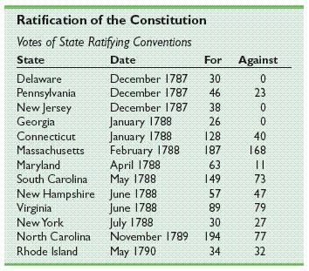
Road to the Constitution

Slide 56
CHECK ON LEARNING
What is the “Necessary and Proper Clause”?
A section of the United States Constitution that enables Congress to make the laws required for the exercise of its other powers established by the Constitution.

Slide 57
Warm-Up 5OCT16
What was the difference b/w the Land Ordinance of 1785 and the Northwest Ordinance of 1787?
Land Ordinance was designed to raise revenue and provide for orderly settlement/NW Ord was designed for how territories would apply for statehood
How are Checks and Balances different from Separation of Powers?
Separation of Powers was so that no one branch would dominate the other branches/Checks and Balances are the powers of each branch to assure equality

Slide 58
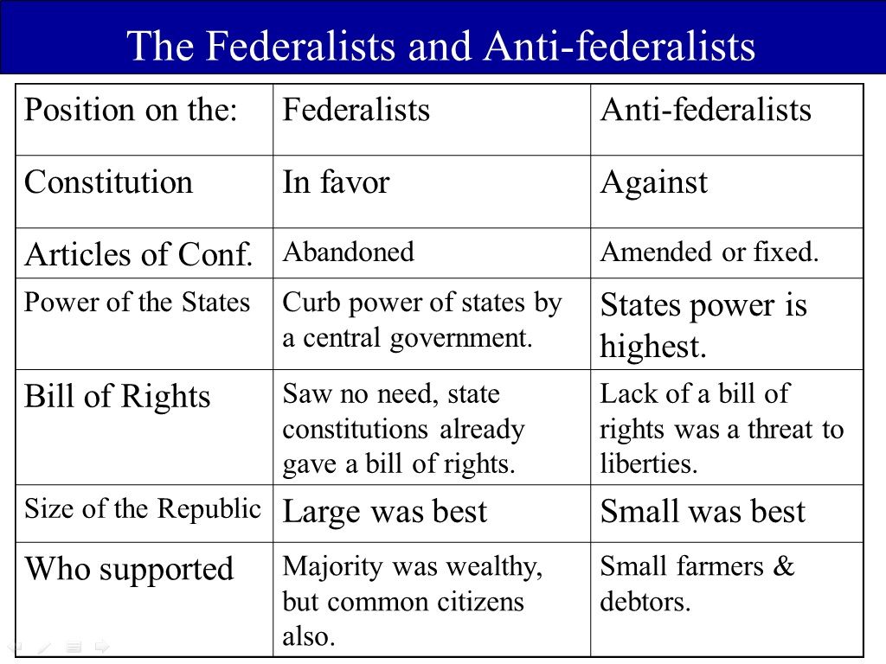
Constitutional Convention

Slide 59
Road to the Constitution

Slide 60
Road to the Constitution
Northwest Ordinance of 1787:
An Ordinance for the government of the Territory of the United States northwest of the River Ohio
Art. 3. Religion, morality, and knowledge, being necessary to good government and the happiness of mankind, schools and the means of education shall forever be encouraged.
“A republic cannot prosper without an educated populace” Thomas Jefferson

Slide 61
Road to the Constitution
Westward Expansion:
Land Ordinance of 1785 – Approved by the Confederation Congress to survey and sell land west of the Appalachian Mountains
Six square miles – 36 sections that were one square mile each
This ordinance applied to the Northwest territory that consisted of Ohio, Indiana, Illinois, Michigan and Wisconsin
Achieved an orderly settlement of the territories
Raised Revenue for the Federal Government

Slide 62
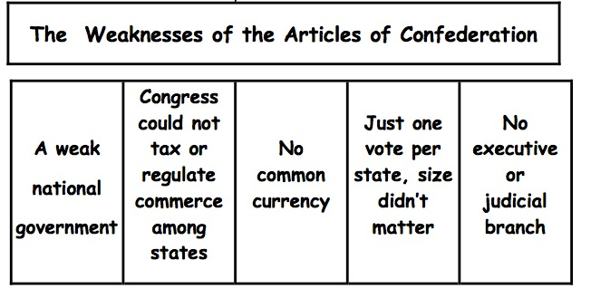
Road to the Constitution
Notes:
5. The Continental Congress drafted and ratified the Articles of Confederation: What were the main weaknesses of the Articles of Confederation?

Slide 63
AofC vs. U.S. Constitution
What document governed the United States from 1781 – 1787? The Articles of Confederation
What were two major weaknesses of this document?
Had no power to collect individual taxes
Amending the AofC was difficult
How did the Constitution fix these problems?
Article I, Section VIII – Paragraph I: The Congress shall have Power To lay and collect Taxes, Duties, Imposts and Excises, to pay the Debts and provide for the common Defence and general Welfare of the United States
The Constitution provides that an amendment may be proposed either by the Congress with a two-thirds majority vote in both the House of Representatives and the Senate. A proposed amendment becomes part of the Constitution as soon as it is ratified by three-fourths of the States (38 of 50 States)

Slide 64
Road to the Constitution
Shays' Rebellion:
As a result of high taxation, Daniel Shays farm was threatened with foreclosure
Shays gathered an army of 1,200 farmers and attacked a federal arsenal in Springfield, MA
Federal troops dispersed Shays’ Army, but it was clear that a better governing document for the United States was needed
Philadelphia Convention: Was scheduled for May 1787 prior to Shays’ Rebellion
Purpose: Revise the A of C

Slide 65
Constitutional Convention
Separation of Powers: Protected the rights of the states, while giving some exclusive powers to the national government; specifically by creating three branches of government
Checks and Balances: Prevented any one branch from becoming too powerful
Examples:
Congress can impeach and remove president
President appoints federal judges
Judiciary can declare acts of Congress unconstitutional

Slide 66
Constitutional Convention
Separation of Powers: Protected the rights of the states, while giving some exclusive powers to the national government; specifically by creating three branches of government
Checks and Balances: Prevented any one branch from becoming too powerful
Examples:
Congress can impeach and remove president
President appoints federal judges
Judiciary can declare acts of Congress unconstitutional

Slide 67
Constitutional Convention
With the efforts of the Anti-federalists, the call for a “Bill of Rights”:
outweighed assurances from the Federalists that the National Government protected the rights of the states
the election of trustworthy leaders would protect the people’s rights
Notes:
4. Why were the Bill of Rights essential to the ratification of the U.S. Constitution? What was purpose of these ten amendments to the Constitution?

Slide 68
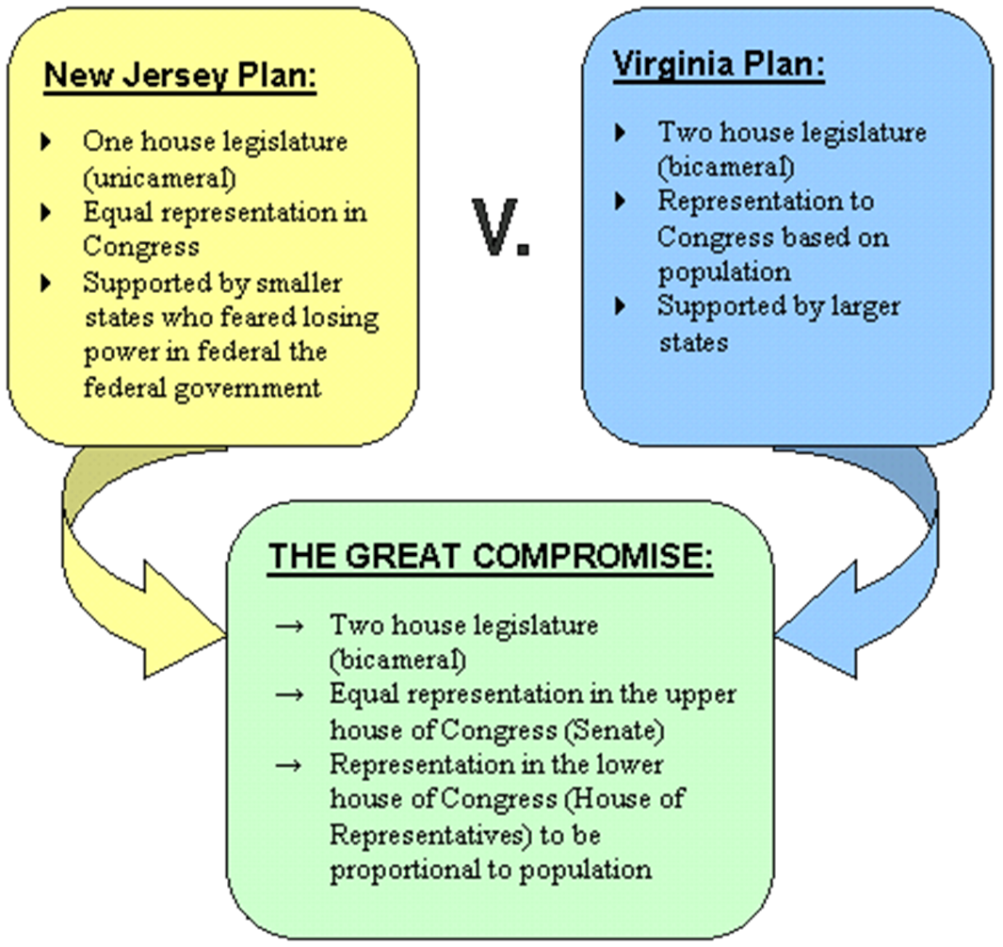
Constitutional Convention
Wanted the Executive Branch to be
“By Committee”
Wanted the Executive Branch to be led by one person

Slide 69
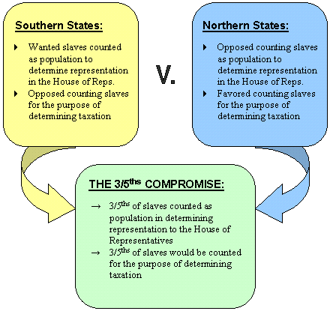
Constitutional Convention
James Madison believed that allowing slavery to continue was a mistake and would cause greater problems in the future
Remained a law until 1865, when the 13th Amendment was passed.

Slide 70
Warm-Up 5OCT16
What was the difference b/w the Land Ordinance of 1785 and the Northwest Ordinance of 1787?
Land Ordinance was designed to raise revenue and provide for orderly settlement/NW Ord was designed for how territories would apply for statehood
How are Checks and Balances different from Separation of Powers?
Separation of Powers was so that no one branch would dominate the other branches/Checks and Balances are the powers of each branch to assure equality

Slide 71
Constitutional Convention
Separation of Powers: Protected the rights of the states, while giving some exclusive powers to the national government; specifically by creating three branches of government
Checks and Balances: Prevented any one branch from becoming too powerful
Examples:
Congress can impeach and remove president
President appoints federal judges
Judiciary can declare acts of Congress unconstitutional

Slide 72
CHECK ON LEARNING
How did the Federalists and Anti-Federalists differ?

Slide 73
CHECK ON LEARNING
What did the Federalists want in their national government?
A Central Government that would be stronger than the individual states
Supremacy Clause: The clause in United States Constitution's Article VI, stating that all laws made furthering the Constitution and all treaties made under the authority of the United States are the “supreme law of the land.”

Slide 74
CHECK ON LEARNING
What did the Anti-Federalists want in their national government?
A Bill of Rights guaranteeing personal liberties
More representation in the Legislative Branch
Less power for the Executive Branch
Believed that the United States was too big to be controlled by a Central Government
Wanted state and local courts to have more power than the federal courts

Slide 75
Constitutional Convention
Why was the Electoral College added to the Constitution?
Due to the lack of political parties, distance and mistrust that the under-educated populace could make good decisions. Those in power sought to create a system in which they could have a semi-guaranteed outcome in each election

Slide 76
Warm-Up 6OCT16
Which Founding Father would have said “If it is not written in the Constitution, then it is not legal/that power belongs to the states”?
Thomas Jefferson
Which Founding Father would have stated “If it is not expressly forbidden in the Constitution, then it is legal”?
Alexander Hamilton

Slide 77
Warm Up– 13OCT16
Who were the main voices of the two political parties that formed in the 1790’s?
Federalists | Democrat-Republicans
John Adams John Jay Alexander Hamilton | Thomas Jefferson James Madison Aaron Burr
Early American Schools

Slide 78
The Early Republic
Alexander Hamilton as Secretary of the Treasury:
Pay off foreign debt and issue new government bonds to replace those sold during the Revolutionary War and under the Articles of Confederation
Federal Government would assume the debts of the states – WHY? Whom did it anger?
Create a National Bank – The Bank of the United States
Issue paper money
Made use of the “Elastic Clause of the U.S. Constitution”

Slide 79
The Early Republic
The Judiciary Act of 1789: The Constitution authorized the Supreme Court and lower courts – but did not explain how to do it
The Supreme Court would consist of a Chief Justice and FIVE Associate Justices
Three Federal Circuit Courts
Thirteen Federal District Courts
Section 25 of the Judiciary Act allowed state court decisions to be appealed to a federal court on issues of constitutionality
Supreme Court is the “supreme law of the land”

Slide 80
The Early Republic
The Whiskey Rebellion:
Started because Alexander Hamilton sought to impose a tax on “distilled spirits”
Many poor farmers made whiskey from their grain because it was easier to transport and sell
Farmers in Western Pennsylvania refused to pay the tax and rebelled
Hamilton saw this as an opportunity to strengthen the Federal Government by putting down the rebellion
15,000 soldiers led by George Washington and Hamilton went to Pennsylvania
The rebelling farmers scattered

Slide 81
Growth of the United States
Jay’s Treaty: Signed November 19, 1794
John Jay was in Great Britain to negotiate control of the land west of the Appalachian Mountains
The results of the Battle of Fallen Timbers caused the British to evacuate their posts in the Northwest Territory
Americans in the NW Territory did not like that the British were allowed to continue their fur trade in the United States
U.S. had to pay lingering debts from the Treaty of Paris
Did not solve the problems with British Navy seizing U.S. Ships
Did allow the U.S. to avoid going to war with Great Britain

Slide 82
Growth of the United States
Alien and Sedition Acts(1798):
Alien Acts raised the residency requirement for U.S. citizenship from 5 to 14 years
Allowed the POTUS to deport “undesirables”
Sedition Acts:
Fines and jail terms for anyone
Expressing “false, scandalous and malicious statements” against the government
USGOVT prosecuted and jailed many Democratic-Republican editors, publishers and politicians
VIOLATED WHICH AMERICAN RIGHT?

Slide 83
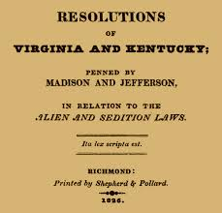
Growth of the United States
Virginia and Kentucky Resolutions:
Led by Thomas Jefferson and James Madison
Virginia (Madison) and Kentucky (Jefferson)
Approved by the state legislatures of VA and KY that states had the right to nullify any act of Congress they deemed unconstitutional

Slide 84
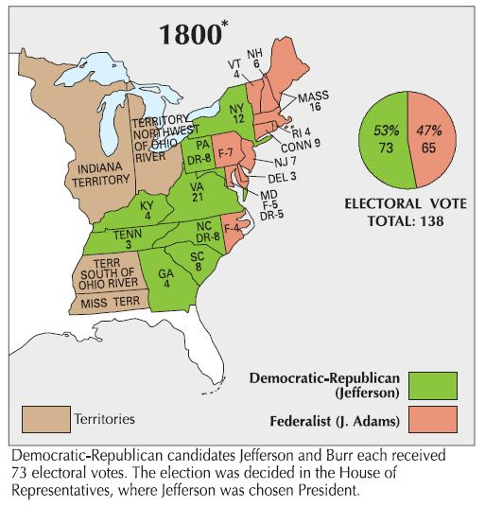
Jefferson’s Presidency
The 1800 Presidential Election:
Jefferson and Burr received the same number of Electoral votes
HofR voted 35 times to declare a winner
Alexander Hamilton convinced Federalists to vote for Jefferson
Jefferson – President
Burr – V.P.
The 12th Amendment was added to cure the problems of this election

Slide 85
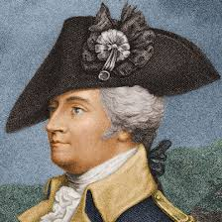
Growth of the United States
The Miami Confederacy:
Native Americans did not accept the provisions of the Treaty of Paris 1783
Used the presence of British troops to strengthen their resistance to American settlers
Miami Confederacy led by Little Turtle defeated federal troops in battles in 1790-1791
The appointment of Gen. Anthony “Mad Anthony” Wayne defeated the Miami Confederacy at the Battle of Fallen Timbers
The Treaty of Greenville ended Indian resistance in Ohio

Slide 86
Jefferson’s Presidency
Louisiana Purchase:
Spain cedes Louisiana Territory to France
Slave revolt in (Haiti) ruined Napoleon’s plans of expanding his empire into North America
Jefferson sends James Monroe to France to purchase New Orleans and western Florida
Napoleon needs Cash
Sell the entire Louisiana Territory for $15 million
Jefferson believed in a strict interpretation of the Constitution and buying land was not in the Constitution
Jefferson submitted the treaty for Senate approval and it was ratified

Slide 87
Growth of the United States
The Treaty of San Lorenzo; aka Pinckney’s Treaty of 1795:
Spain feared that the U.S. and Great Britain would combine to take the Louisiana Territory from Spain
Spain ceded the Louisiana Territory to France in 1800 with the Third Treaty of San Ildefonso
Spain and the U.S. signed the Treaty of San Lorenzo which…

Slide 88
Review Activity
mrwheelerhistory.weebly.com
Slides are in Unit 3
Notes:
5. The hesitation of Virginia and New York to ratify the Constitution led to what great concerns which factors led New York to ratify the Constitution?

